Slide 1
Quality Refresher

Slide 2
Troubleshooting
We use 2 tools for troubleshooting:
ITT Intelligent Troubleshooting Tool
We use it for
TV and Remote
MT Modem Troubleshooter
We use it for
Internet and voice

Slide 3
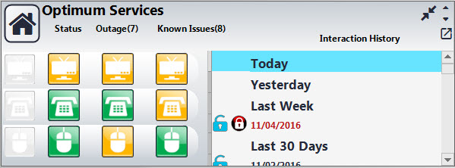
Before troubleshooting
On the Dash Board
Reading the Status Lights
Green – all devices under that category are with in good condition
Yellow – means at least one device in that category is offline or out of range
Red – all devices of that category are offline
You must verify the dashboard and outage board to confirm there are no outages in the member’s area.
Next

Slide 4
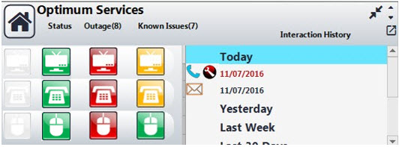
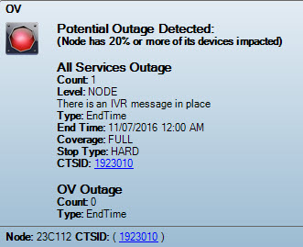
If there is an outage...
Fast Detect Message
High chance customer is not impacted
Apologize and assure the customer we are working on it. Document on your notes using the CTSID’s or outage number
CTSID’s are now clickable

Slide 5
If there are no outages...
Three Troubleshooting Questions
1. What type of modem does the customer have?
2. What are lights doing on this modem?
3. What is the MAC address on this modem?
Proceed to troubleshoot
Run your tools

